Slide 1



Slide 2
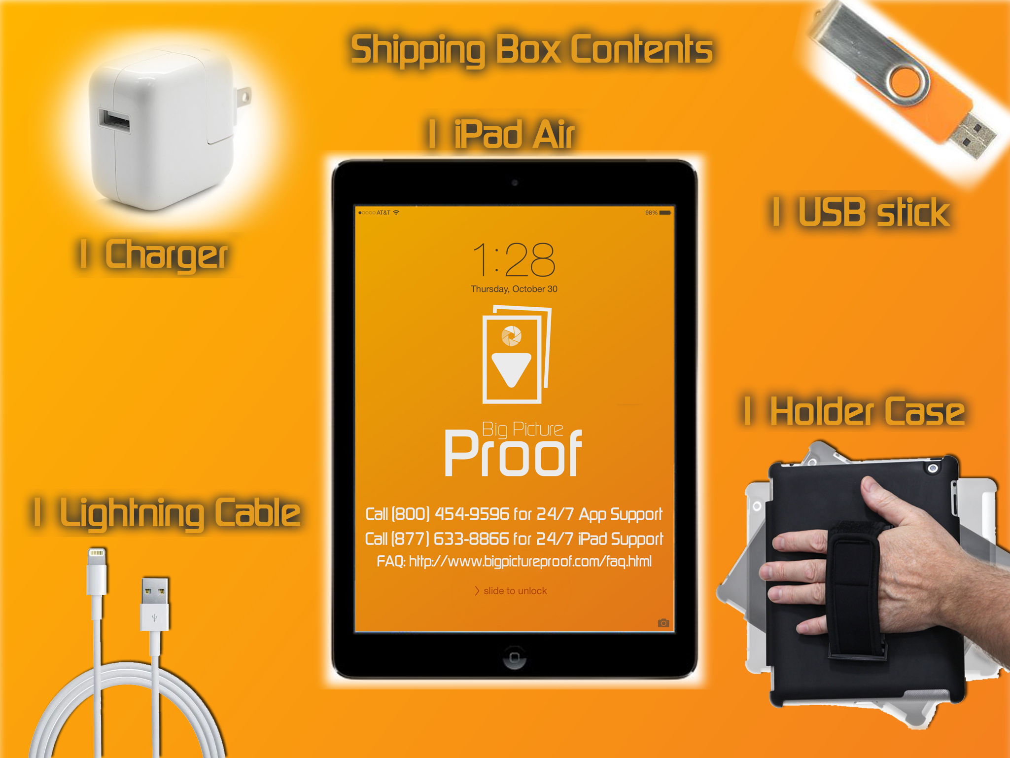
Using the APP
Notes:
Take the device out of it's case/box.
2

Slide 3
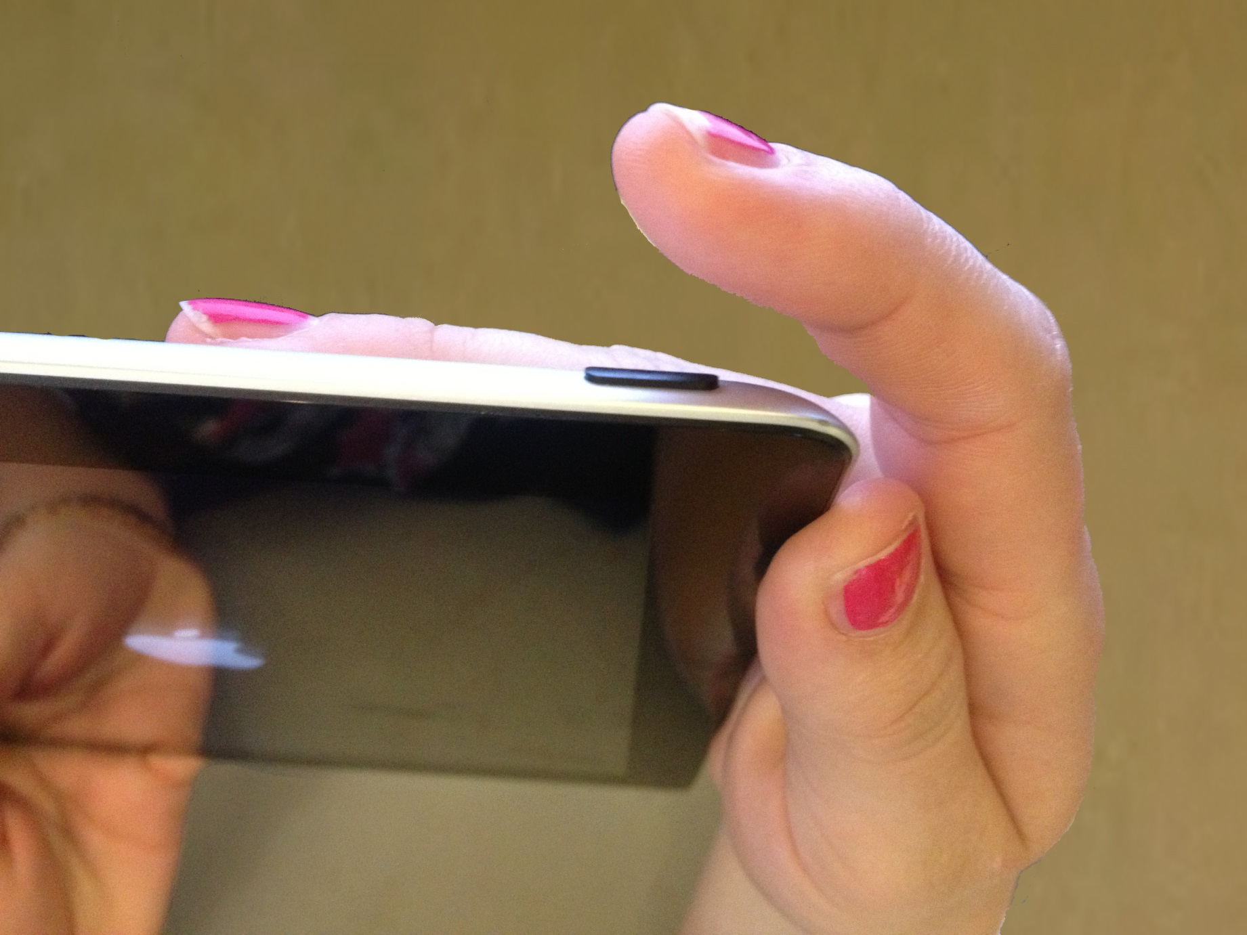
Using the APP
Power up the unit
Notes:
Power up the unit, like this.
3

Slide 4
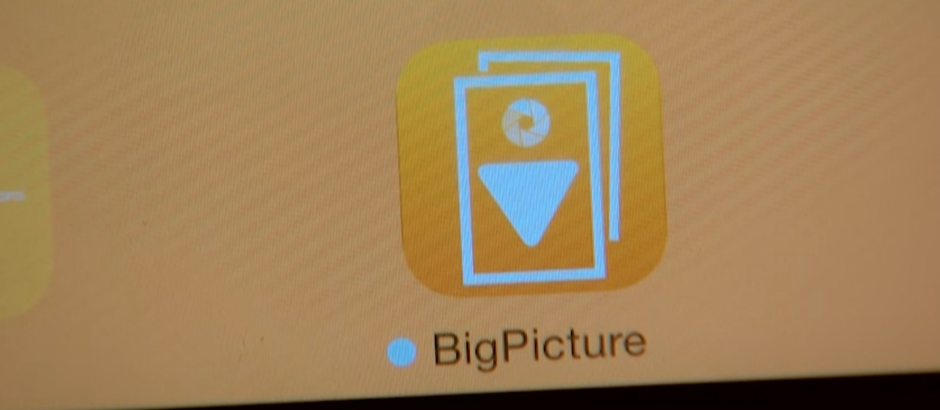
Using the APP
Start the app
Notes:
Start the app, like this
4

Slide 5
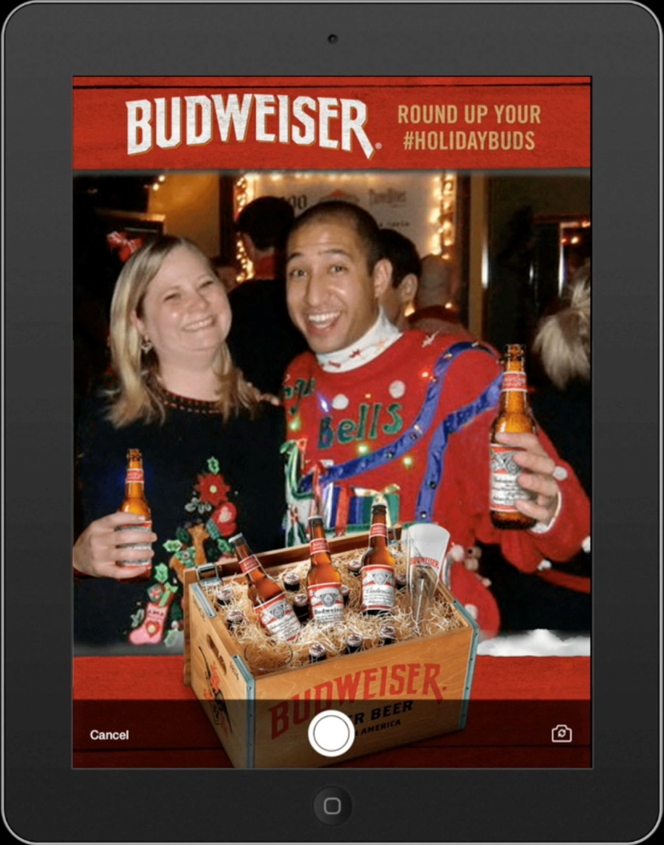
Take a relevant picture of yourself or others, like this
Notes:
Take a relevant picture of yourself or others, like this
5

Slide 6
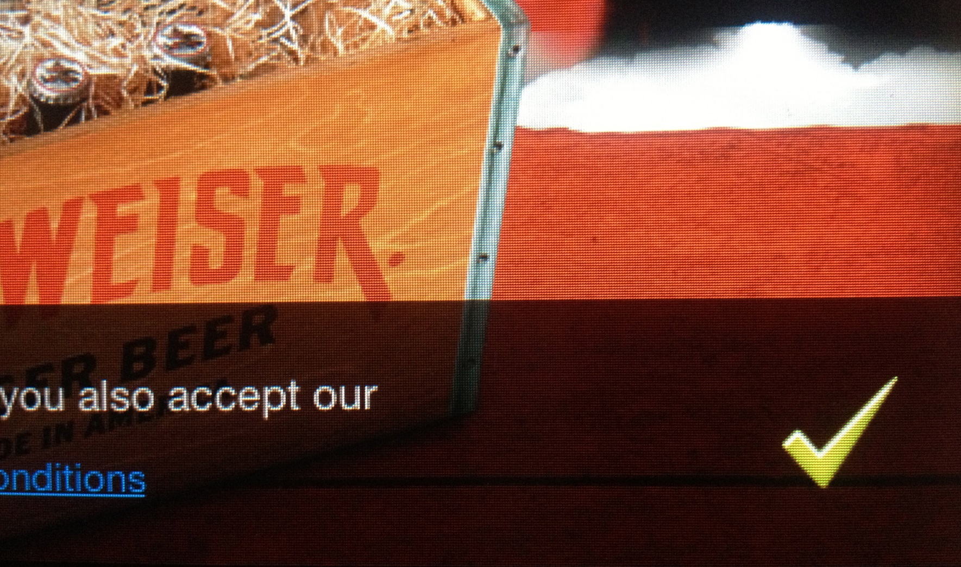
Approve the picture, agreeing you liked it,
like this
Notes:
Approve the picture, agreeing you liked it, like this
6

Slide 7
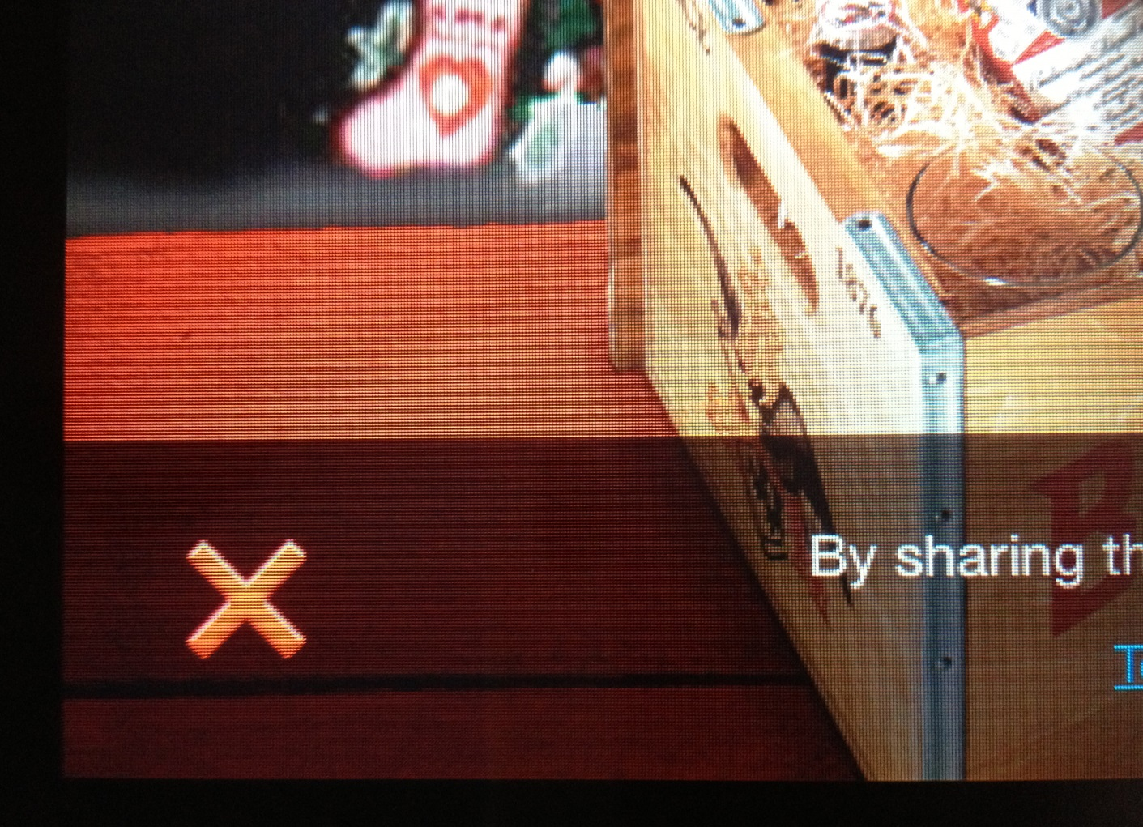
…or retake the photo, like this
Notes:
…or retake the photo, like this.
7

Slide 8
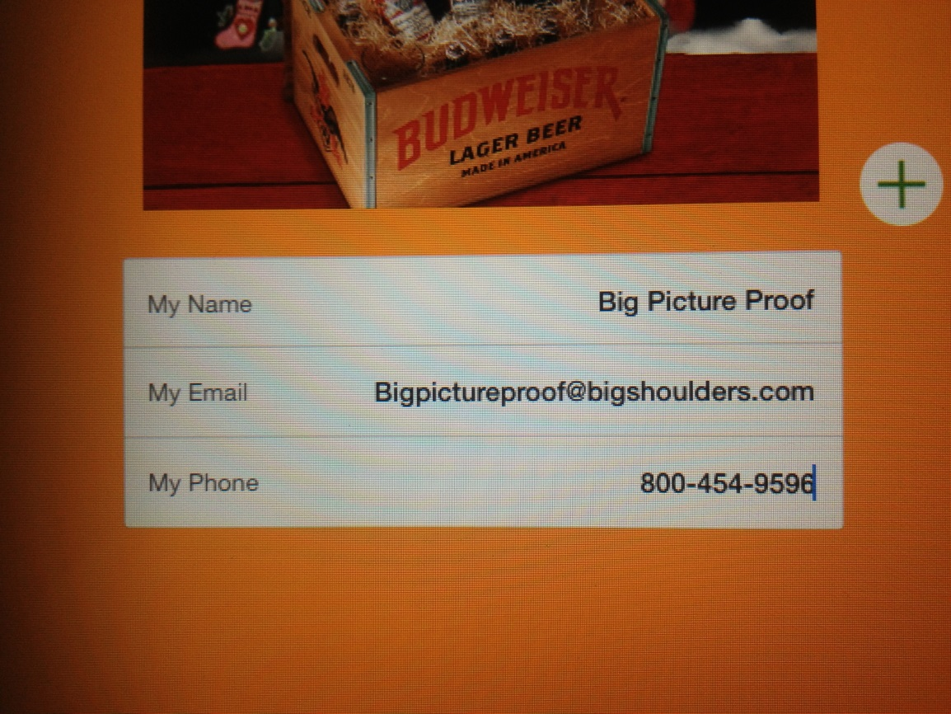
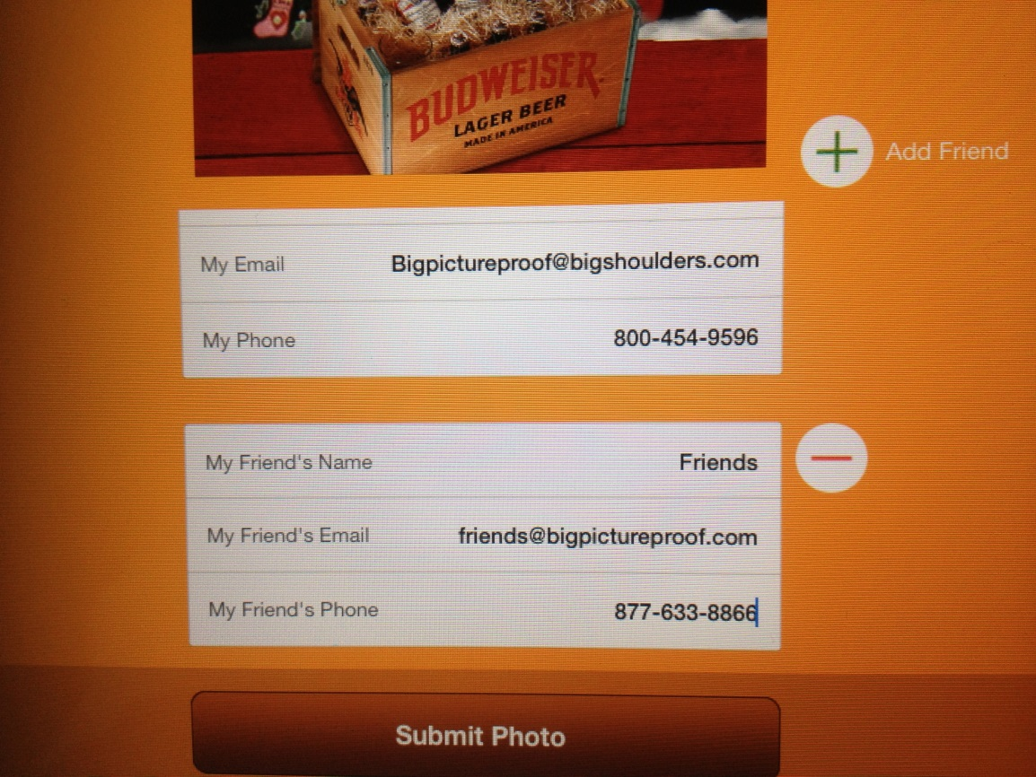
Once Approved
email it to yourself and others
Notes:
Once an approved photo, email it to yourself and a minimum of others if at all possible
8

Slide 9
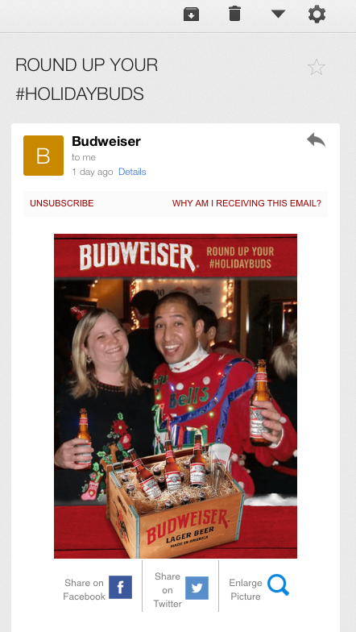
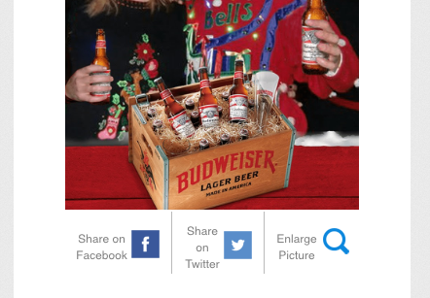



Review the email and
share on social media
Notes:
Review the email and share on social media, like this
9

Slide 10
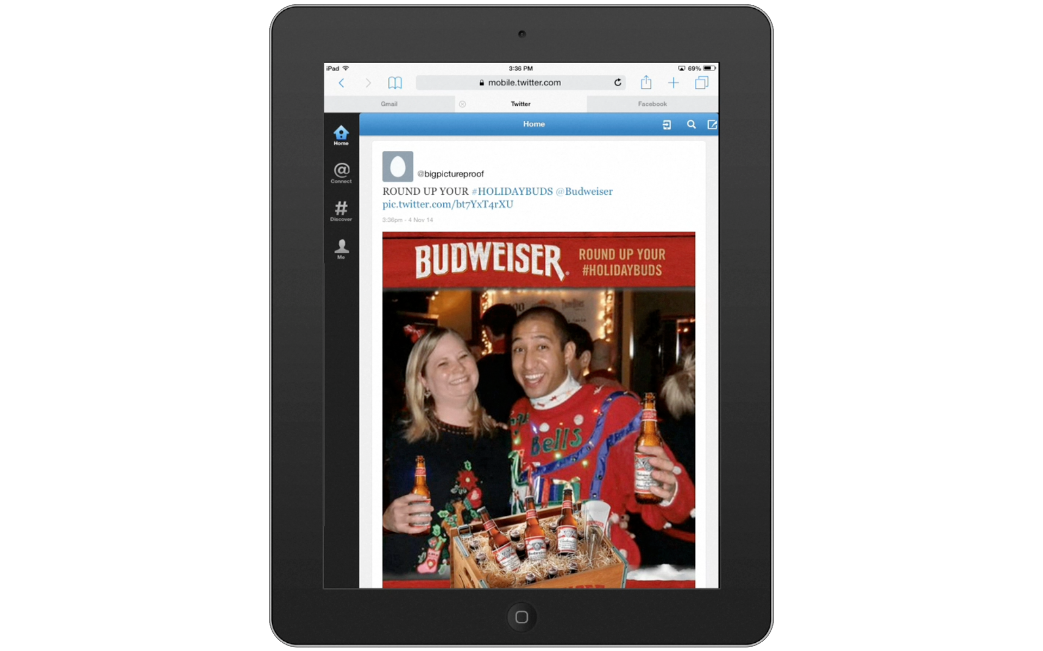

Check social media to ensure the posting, like or retweet the post
Notes:
Check social media to ensure the posting, like or retweet the post
10

Slide 11
Once you are confident that your test has proven the app is at full functionality you're all set to start using the app on location
Notes:
Once you are confident that your test has proven the app is at full functionality you're all set to start using the app on location
11

Slide 12
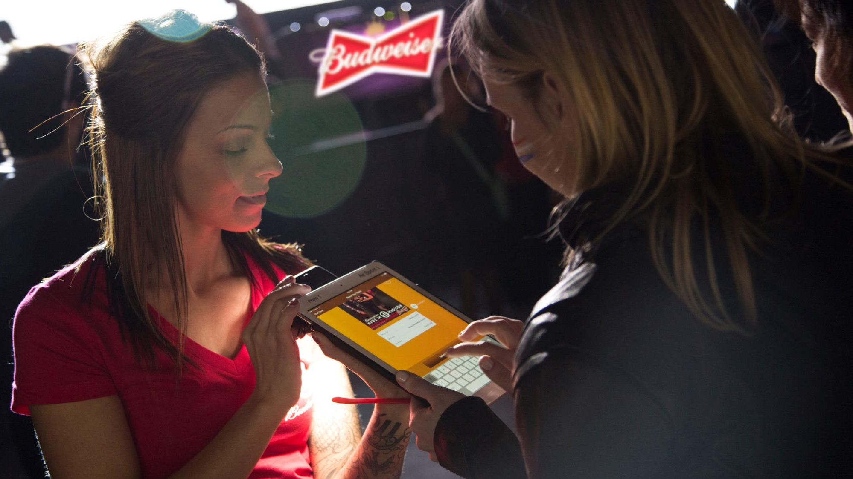
Engage consumers
Notes:
Engage consumers
12

Slide 13

Take their photo
Notes:
Take their photos
13

Slide 14
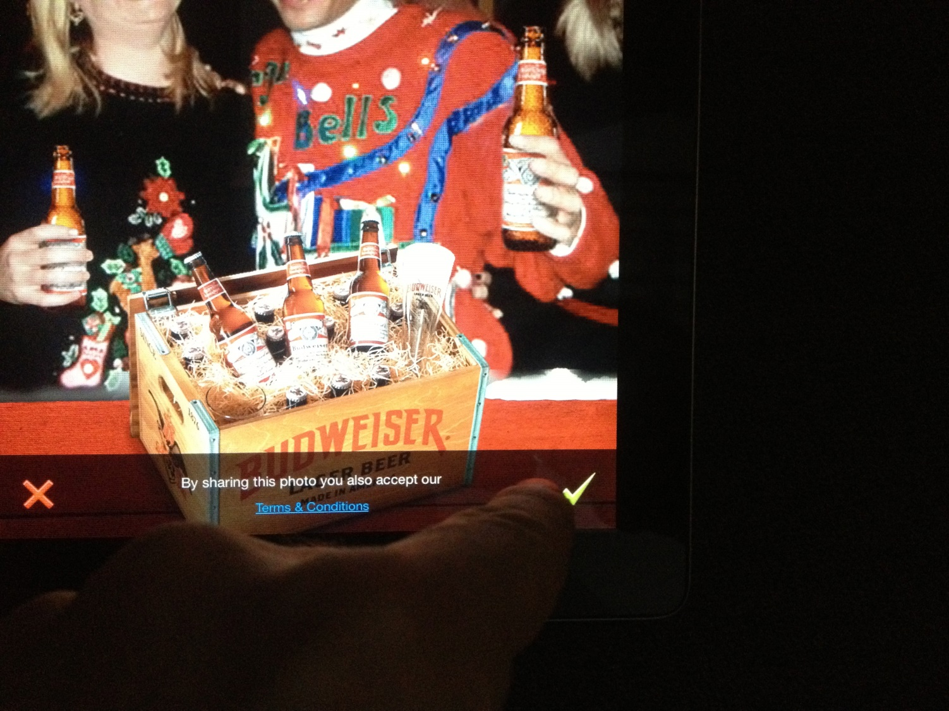
Have them approve it
Notes:
Have them approve it
14

Slide 15
try to get them to email the photo to themselves and to share it on social media, if they are unwilling to email and share that way they can always share directly to Facebook or twitter, like this
Notes:
Try to get them to email the photo to themselves and to share it on social media, if they are unwilling to email and share that way they can always share directly to Facebook or twitter, like this
15

Slide 16
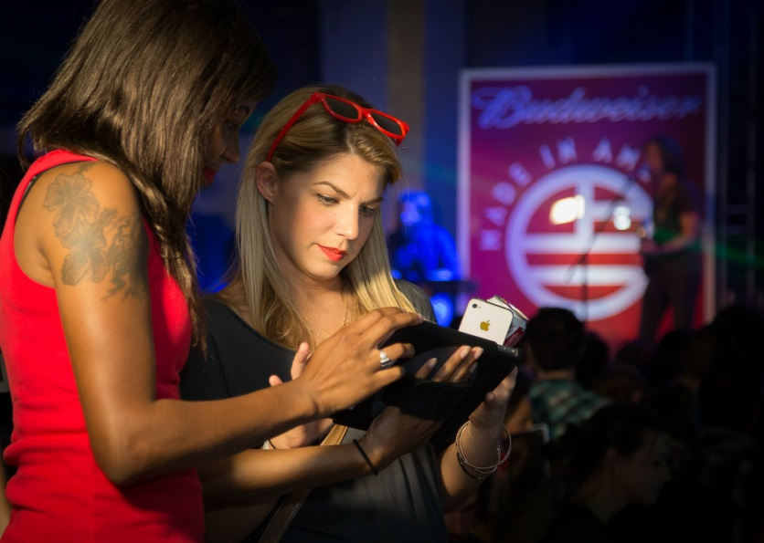

While folks are filling out the form. If you have another ipad, begin the process all over again. With two units you should always be taking a photo while the other unit is sharing the photo
Notes:
While folks are filling out the form. If you have another Ipad, begin the process all over again. With two units you should always be taking a photo while the other unit is sharing the photo.
16

Slide 17
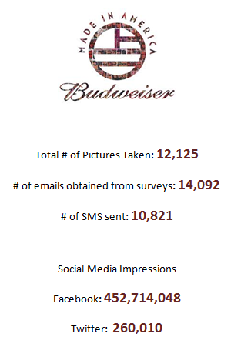
at the end of the event or if you have a long break during the event, check photos and analytics, brag about the successes of your event with the confidence that you have the proof to back it up.
Notes:
At the end of the event or if you have a long break during the event, check photos and analytics, brag about the successes of your event with the confidence that you have the proof to back it up.
17

