Slide 1

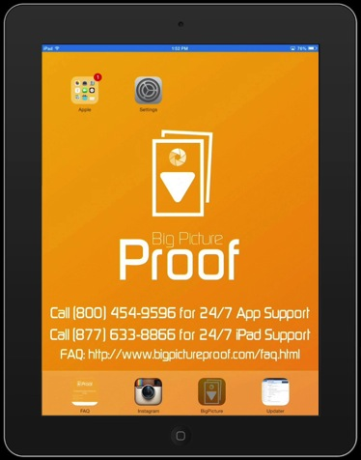
Big Picture Proof App
If there are any questions that this presentation can not answer,
please call:
(800) 454-9596 for 24/7 App Support
(877) 633-8866 for 24/7 iPad Support

Slide 2
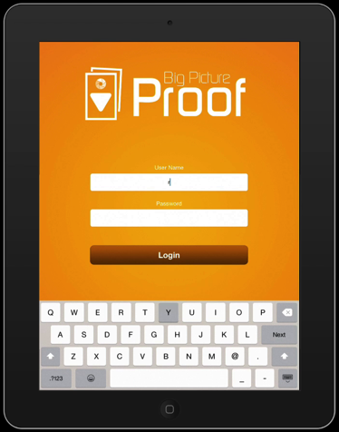
Login Screen
Enter your Username and Password.
Email: admin@bigpictureproof.com
if you have not received your login information.

Slide 3
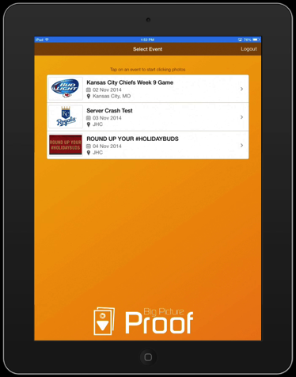
Events Screen
All events will be shown in chronological order
Select your event to activate the Camera

Slide 4
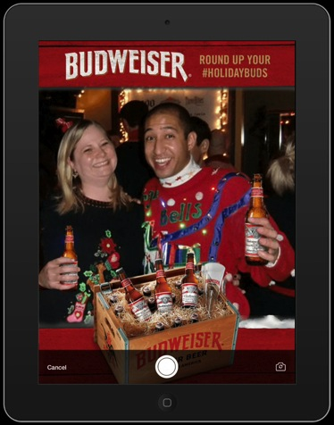
Camera Screen
Now that the camera is active you can engage with the consumer. Take a pic. If they don’t like it, take another!

Slide 5
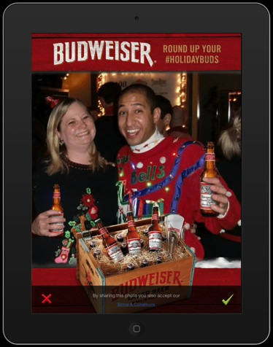
Camera Screen
Once they have one they like, click on the green check mark to continue.

Slide 6
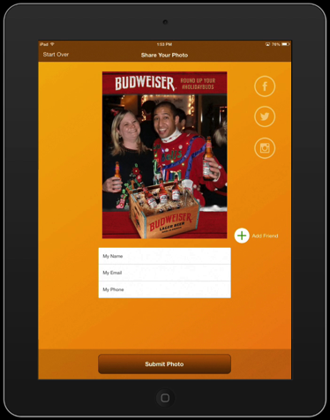
Share Screen
From here you first share by Email and by Text. Enter their name, email address and phone number.

Slide 7
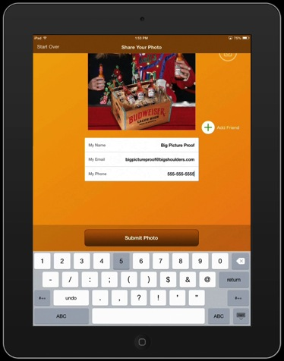
Share Screen
From here you first share by Email and by Text. Enter their name, email address and phone number.
Either an email address of a phone number is required, but not both.

Slide 8
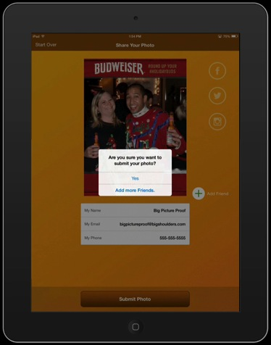
Share Screen
It will prompt you incase you want to add more friends.

Slide 9
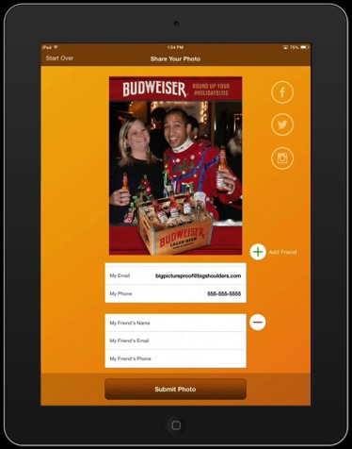
Share Screen
It is quick and easy to add as many friends as they want. Simply use the Add Friend button on the right to add as many friends as necessary.

Slide 10
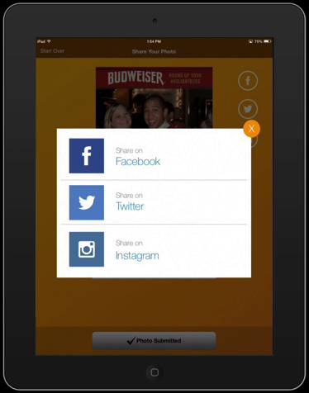
Social Media Share Screen
We recommend they share using the links in the email. But if they are adverse, they can share immediately to Facebook, Twitter or Instagram from the App.

Slide 11
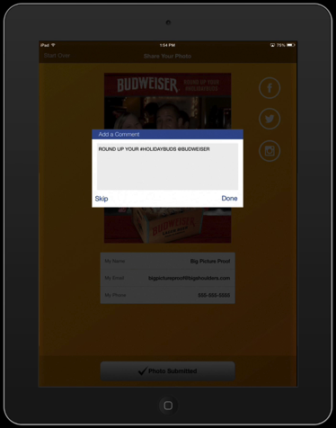
Social Media Message Screen
When they select either Facebook or Twitter they will first be prompted to add a message to the post.
Each event has a pre-populated message.

Slide 12
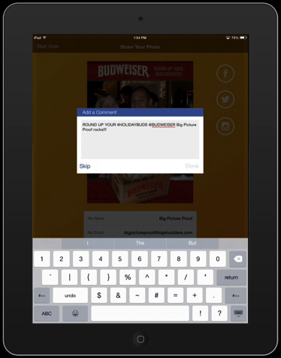
Social Media Message Screen
When they select either Facebook or Twitter they will first be prompted to add a message to the post.
Each event has a pre-populated message.
But they can easily type in anything else they like or tag friends.

Slide 13
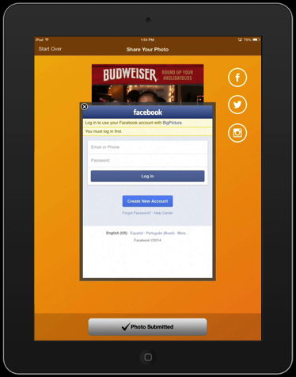
Facebook Login Screen
Now they only need to log into their Facebook account to share the photo to their timeline.
The Big Picture Proof App does not save any login information.

Slide 14
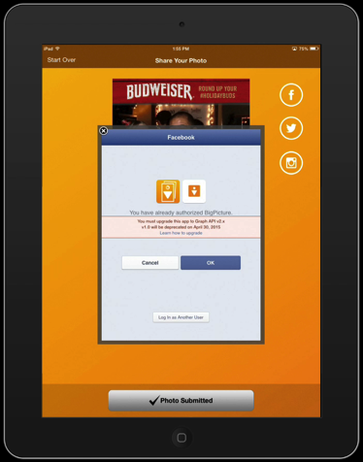
Facebook Timeline Share Screen
They must agree to let the Big Picture Proof App post to their Timeline.

Slide 15
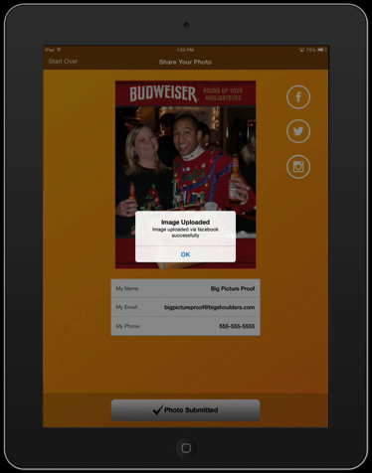
Facebook Share Confirmation Screen
When the picture has been posted you will see this confirmation!

Slide 16
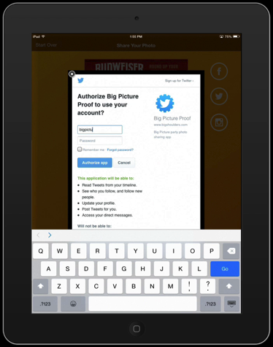
Twitter Login Screen
Just as with Facebook, they must enter their login information to share on their wall.
The Big Picture Proof App does not save any login information.

Slide 17
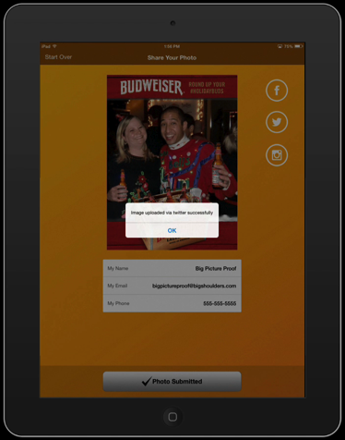
Twitter Share Confirmation Screen
When the picture has been posted you will see this confirmation!

Slide 18
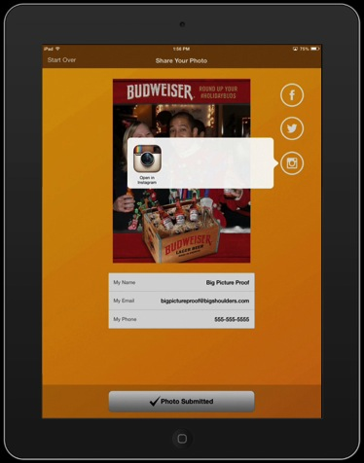
Instagram Open App Screen
Instagram sharing is a little different. Click the Instagram icon to launch Instagram.

Slide 19
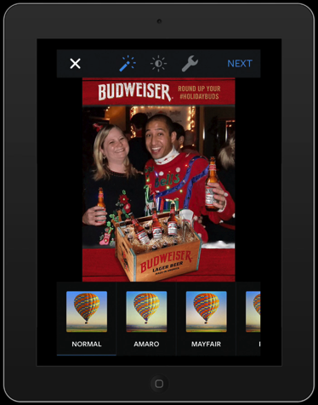
Instagram Share Screen
In Instagram you can now add filters or make adjustments. Click NEXT to continue.

Slide 20
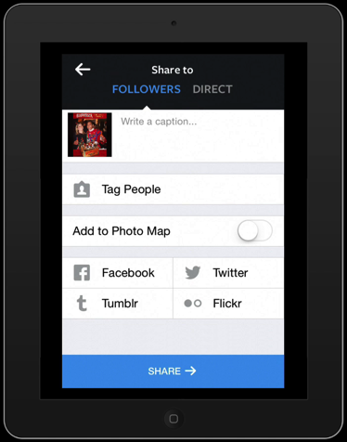
Instagram Share Screen
Here you can add a comment and tag friends.

Slide 21
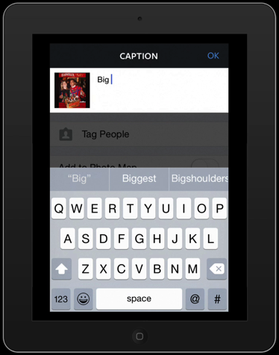
Instagram Message Screen
Here you can add a comment and tag friends.

Slide 22
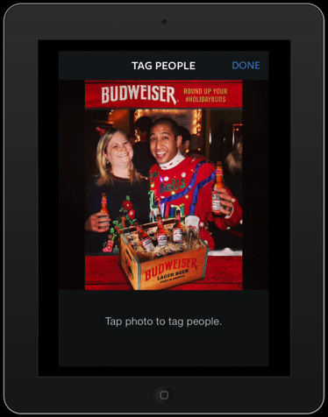
Instagram Tagging Screen
Here you can add a comment and tag friends.

Slide 23
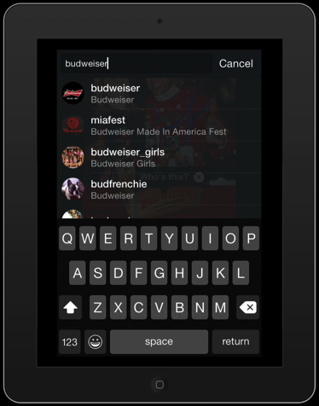
Instagram Tagging Screen
Here you can add a comment and tag friends.

Slide 24
Instagram Share Screen
When you are done click the SHARE button.

Slide 25
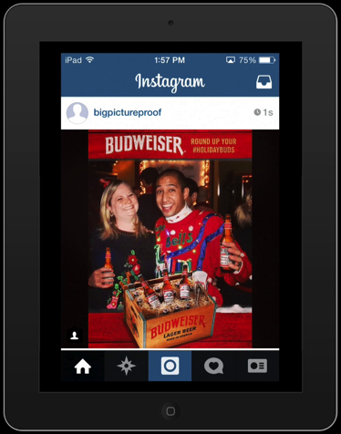
Instagram Screen
You have now shared on Instagram.

Slide 26
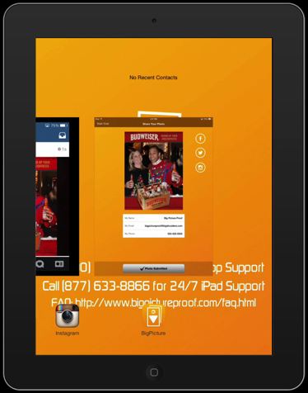
Going Back to App Screen
Double tap the Home button on the iPad and return to the Big Picture Proof App.

Slide 27
Share Screen
After you are done sharing its time to move onto another group of consumers and take more picture.
Click START OVER to go back to the camera.

Slide 28

Camera Screen
Start taking pictures!

