Slide 1


Big Picture Proof iPad Screen
The Settings ICON is where you will connect to WiFi hotspots, turn on Cellular Data and make sure all Pictures taken during the activation have been uploaded.
Click to open Settings.

Slide 2
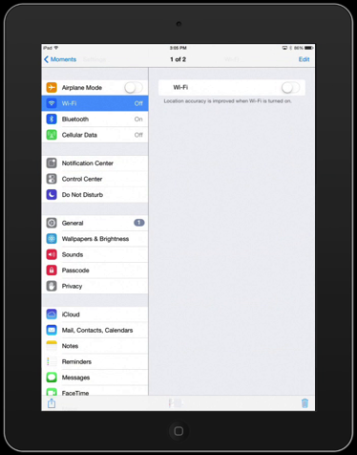
WiFi Screen
Turn on WiFi by selecting WiFi on the left and taping the button on the right turning it green.

Slide 3
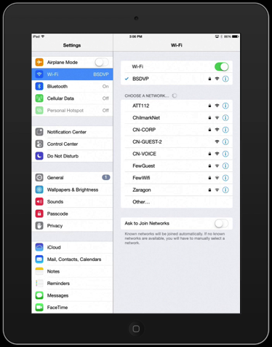
WiFi Networks Screen
Turn on WiFi by selecting WiFi on the left and taping the button on the right turning it green.
Now you will see WiFi hotstops/networks available to you. Select one to join. A password may be required.
Always connect using WiFi when available.

Slide 4
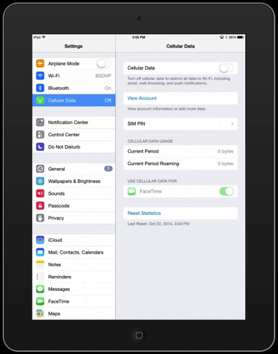
Cellular Data Screen
Turn on Cellular Data by selecting Cellular Data on the left and taping the button on the right turning it green.

Slide 5
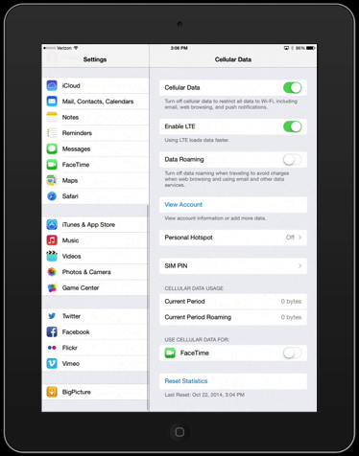
Cellular Data Screen
Turn on Cellular Data by selecting Cellular Data on the left and taping the button on the right turning it green.
Although Cellular Data is always available, signal strength varies by location and traffic.
Always connect using WiFi when available.

Slide 6
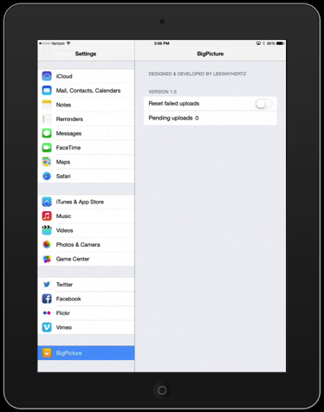
Pending Uploads Screen
After every activation, depending on internet connection and rate of pictures being taken, you may have pending uploads of pictures.

Slide 7
Pending Uploads Screen
Scroll to the bottom of the left menu and click on the Big Picture name to see if there are any Pending Uploads on the iPad. If so, do not turn off the iPad until Pending Uploads is 0.
You may have to move to an area with better connectivity away from the activation for the uploads to complete.

